Slide 1
Service Now PDF Generator
Installation and solutions

Slide 2
Useful Links
Downloading the PDF Generator From the Developer Site:
https://developer.servicenow.com/app.do#!/share/contents/3429377_pdf_generator?v=1.02&t=PRODUCT_DETAILS
Filling PDF forms in ServiceNOW
https://community.servicenow.com/community?id=community_blog&sys_id=4acc6265dbd0dbc01dcaf3231f961949

Slide 3
How to Download the PDF Generator
The PDF Generator is available for FREE from the Service Now Share
Service Now “Share” is a free open-source Developer Community
All Developers can contribute freely accessible/resuable code here.
Update Sets can be used for Configuration Management Changes
But they can also be used to “Export/Import” all changes via 1 XML file.
The PDF Generator is saved to this site as an XML File that can be imported.
Download this xml file (Must register a free Developer Account first)
Then click the Blue Button to download the XML file to your Computer

Slide 4
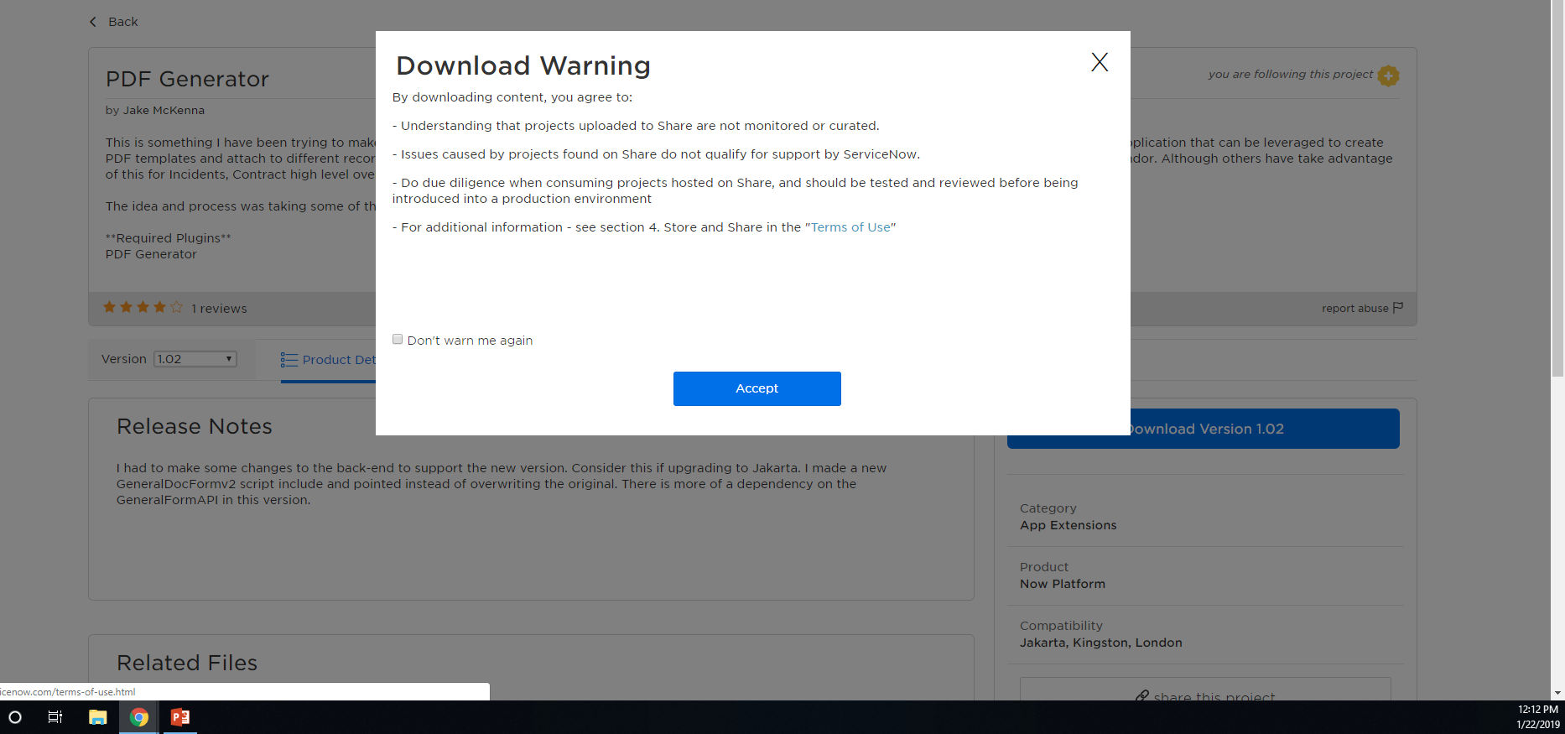

Slide 5
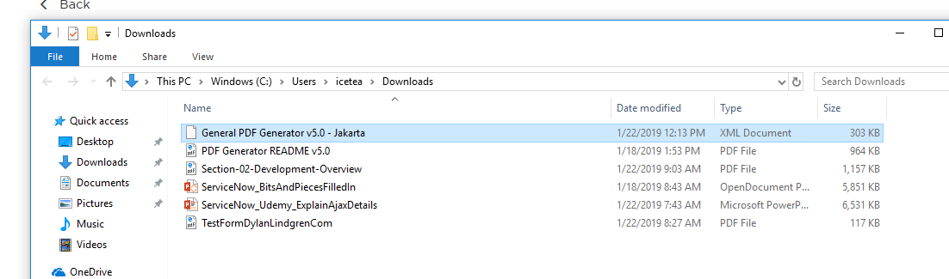

Slide 6
How to Install the PDF Generator
To install the PDF Generator plugin, you must startup your dev instance
Then search for “update set” in the navigation / search field.
Next, you select “Update Sources” from the left-hand menu.
Then locate and click the “Import Update Set from XML”
(See Illustration on next slide)

Slide 7
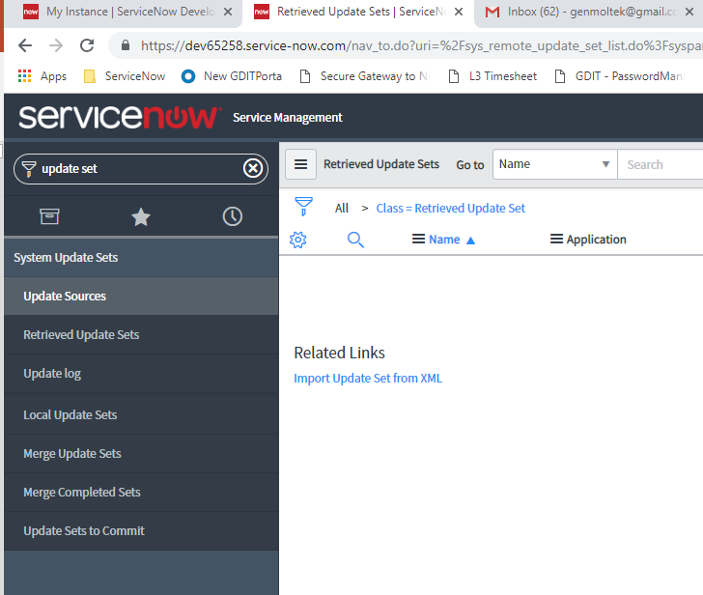
1
2
3

Slide 8
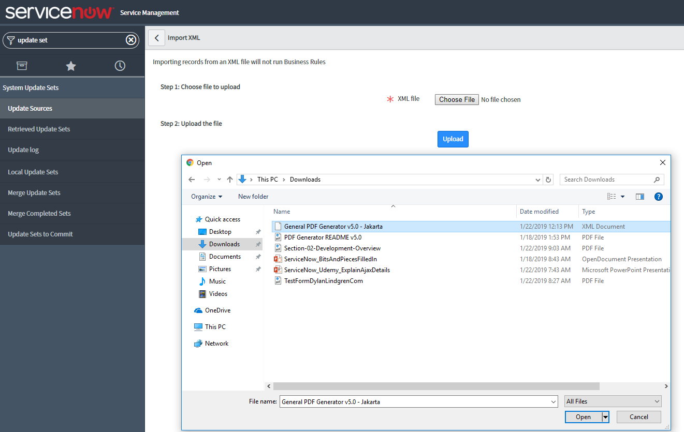
4
6
5

Slide 9
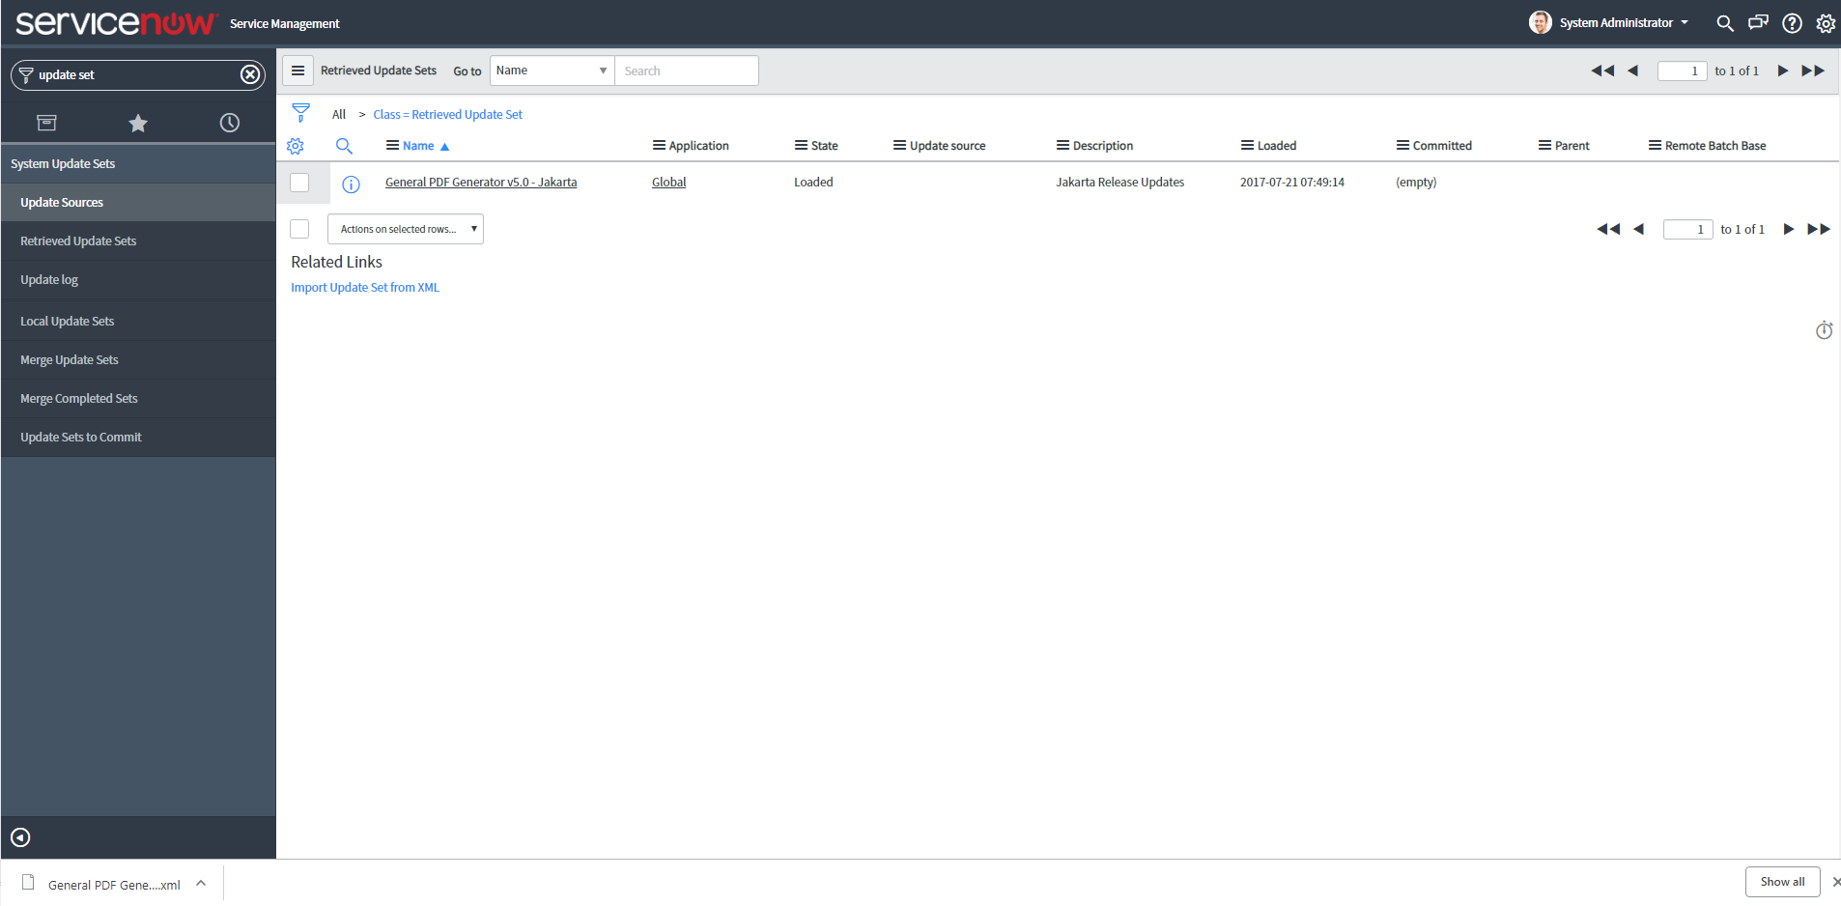

Slide 10
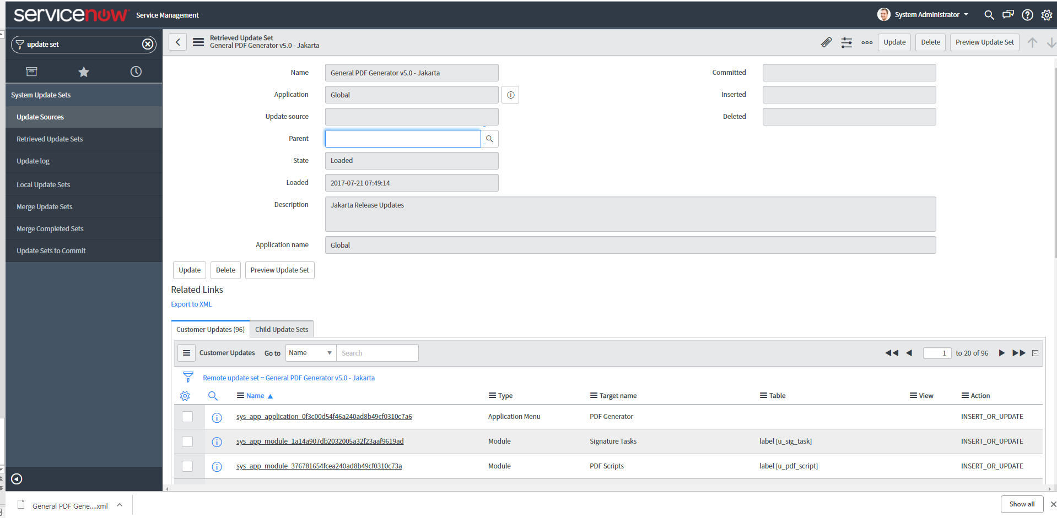

Slide 11
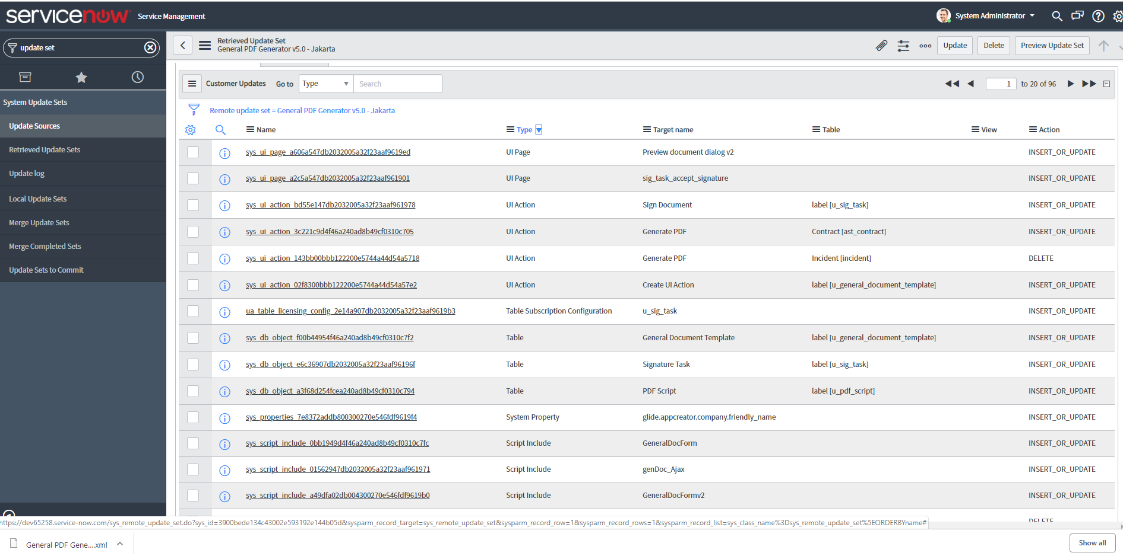

Slide 12
Must Preview Changes before the update set can become official / visible / usable

Slide 13
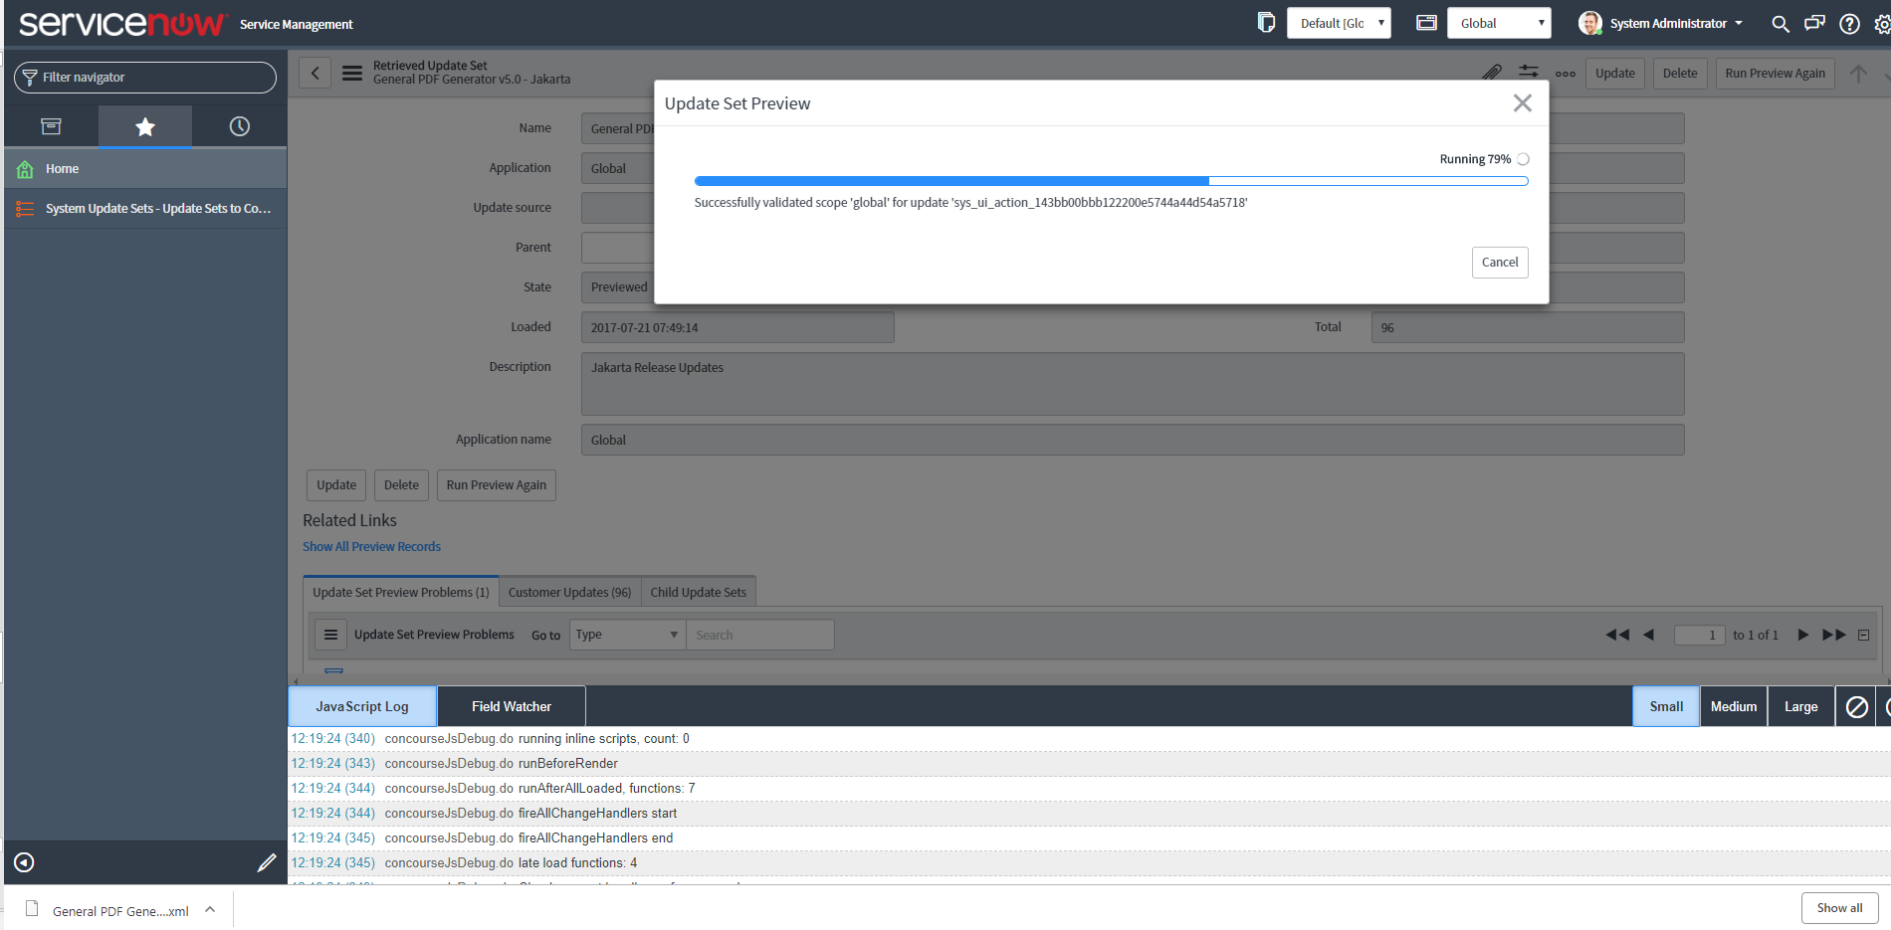

Slide 14
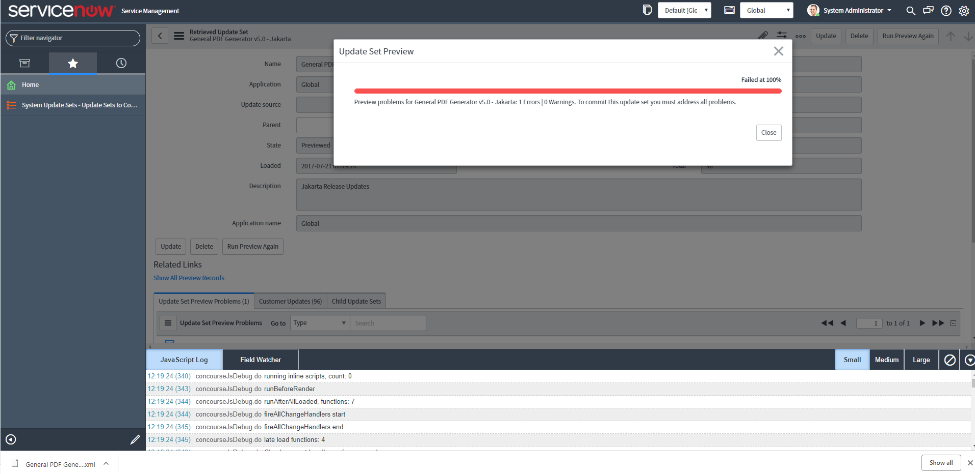

Slide 15
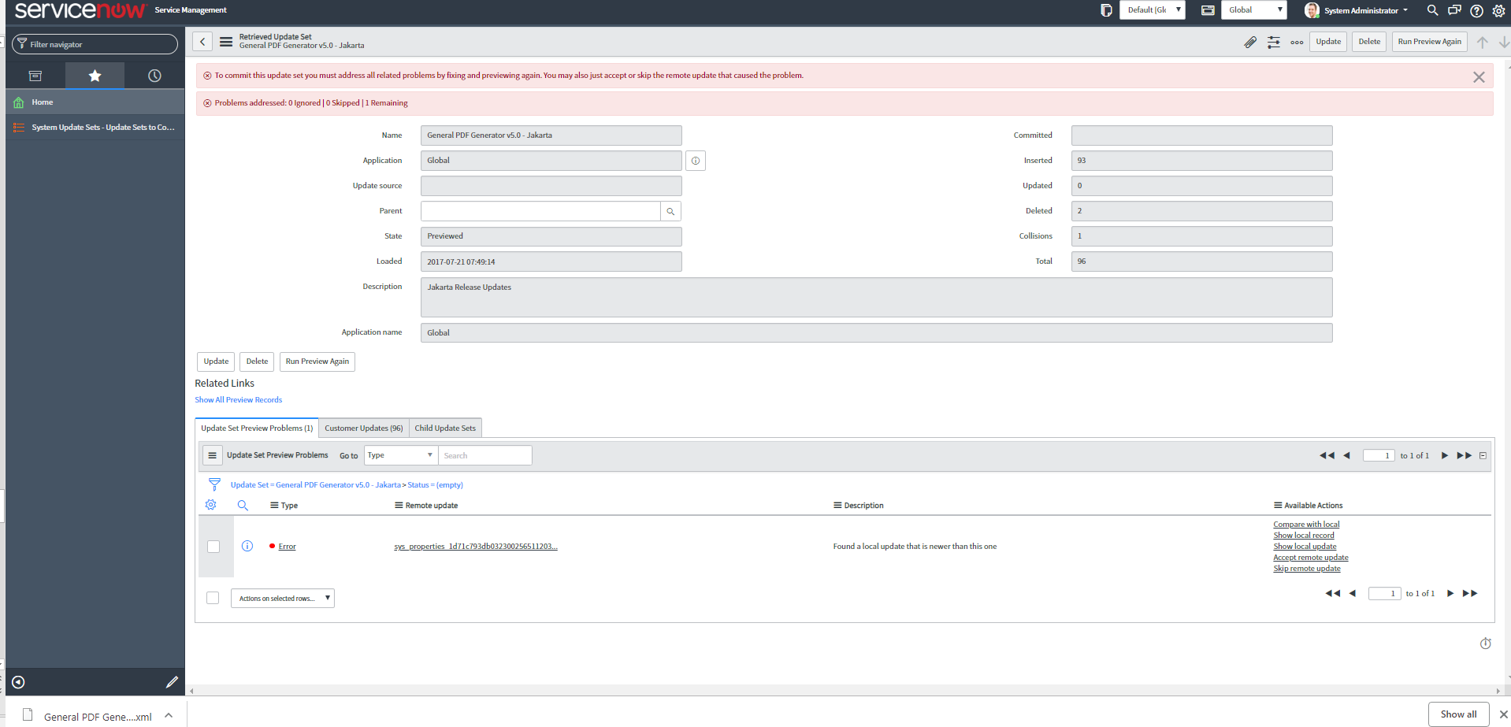

Slide 16
Must Resolve Issues before Commit Allowed

Slide 17
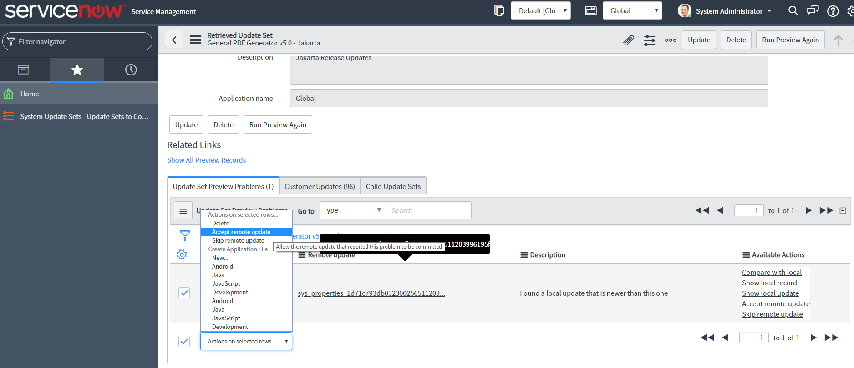

Slide 18
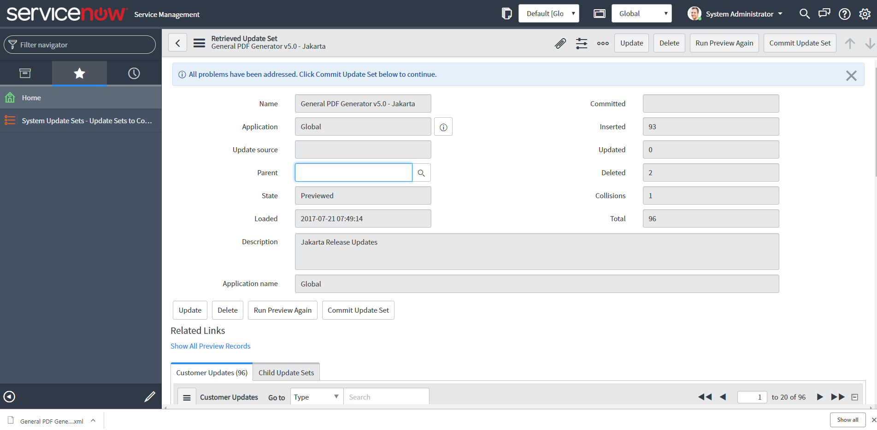

Slide 19
Now Commit Button is Visible. Click it

Slide 20
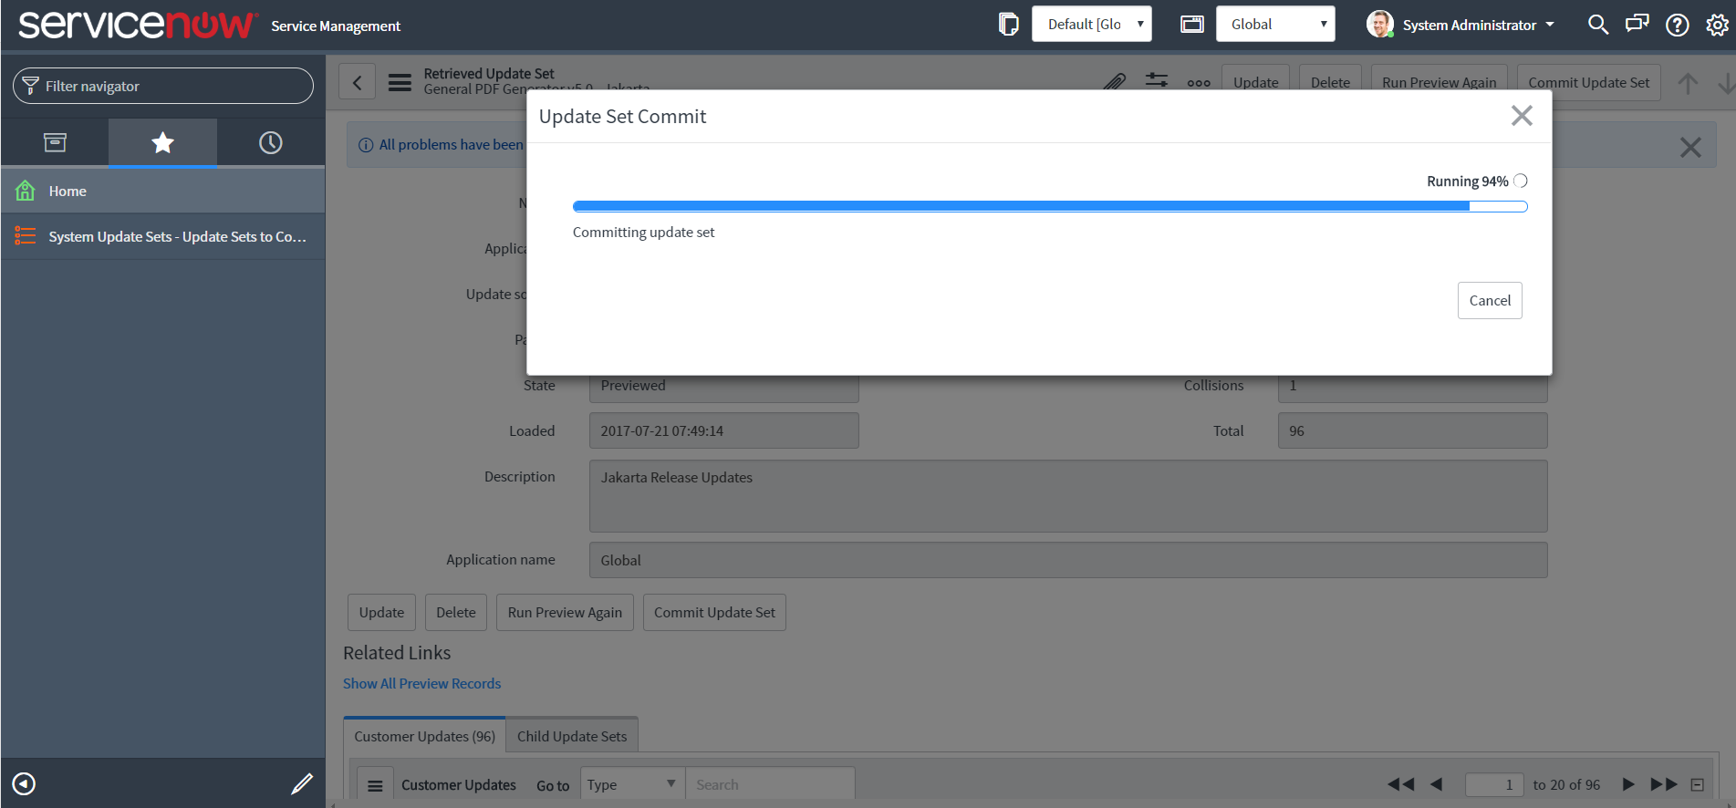

Slide 21
Verify The Install Was Successful

Slide 22
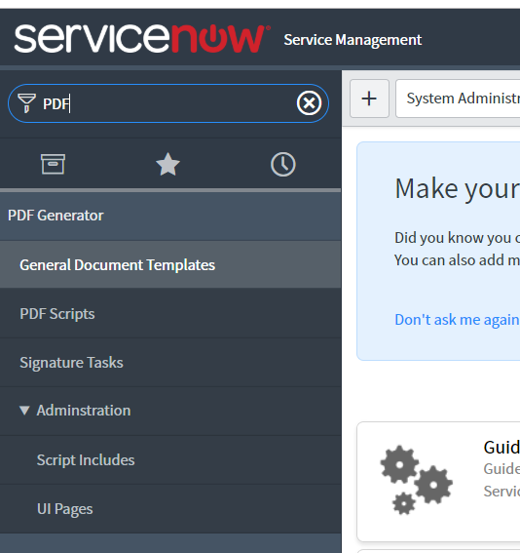

Slide 23
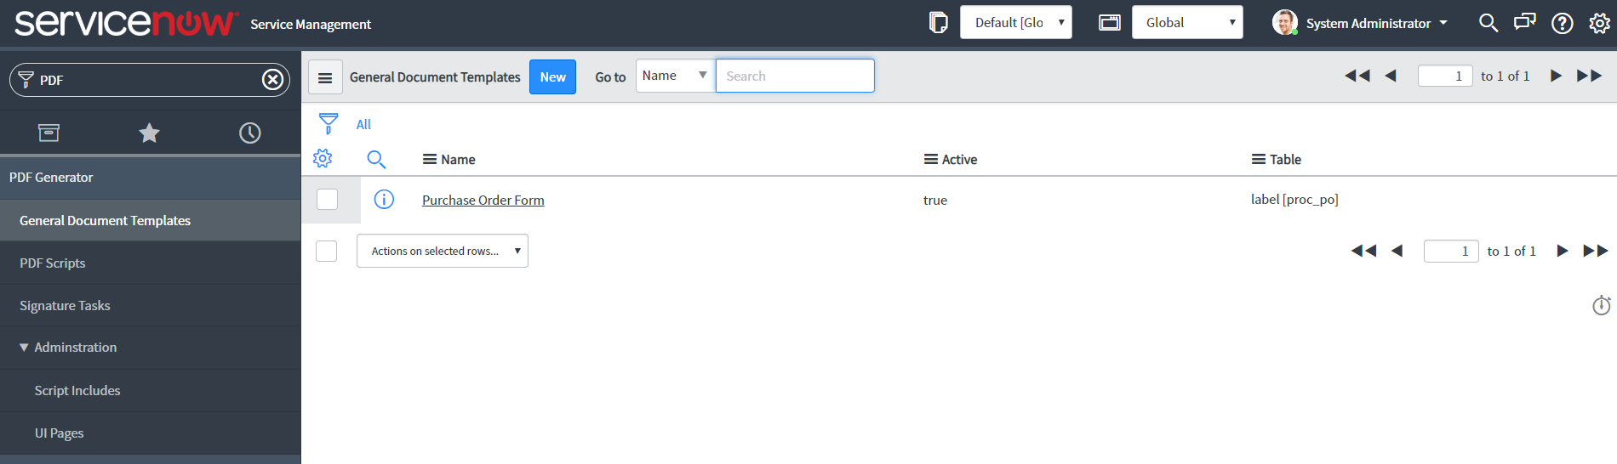

Slide 24
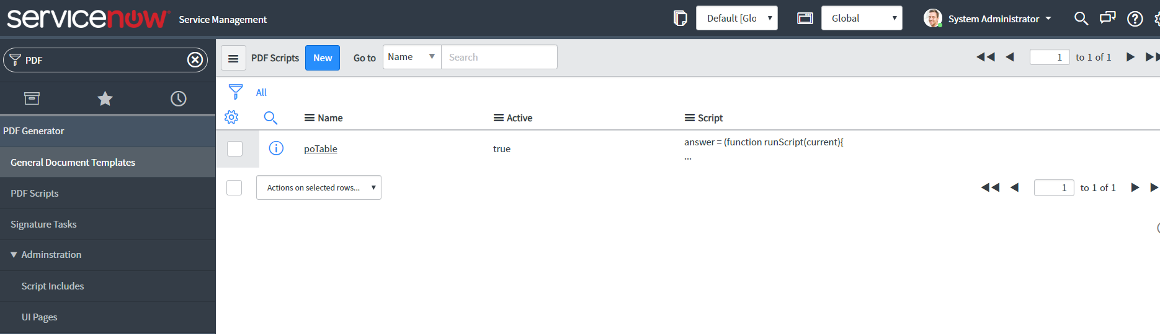

Slide 25
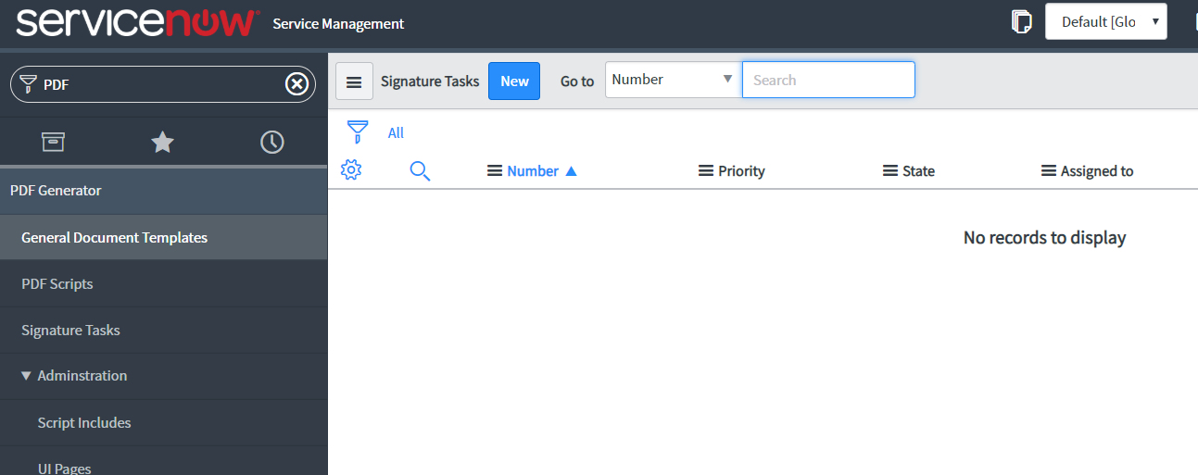

Slide 26
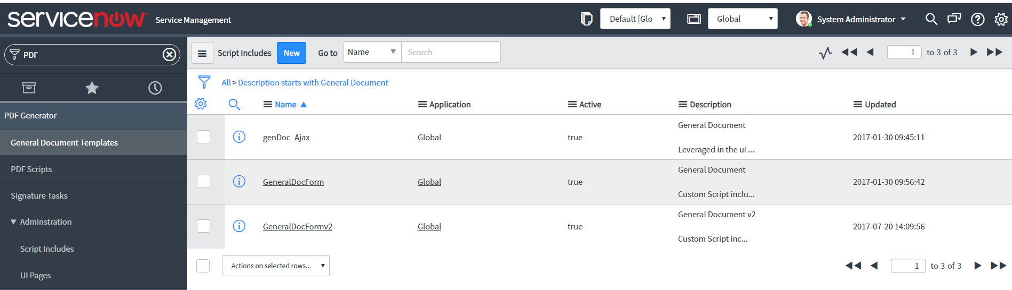

Slide 27
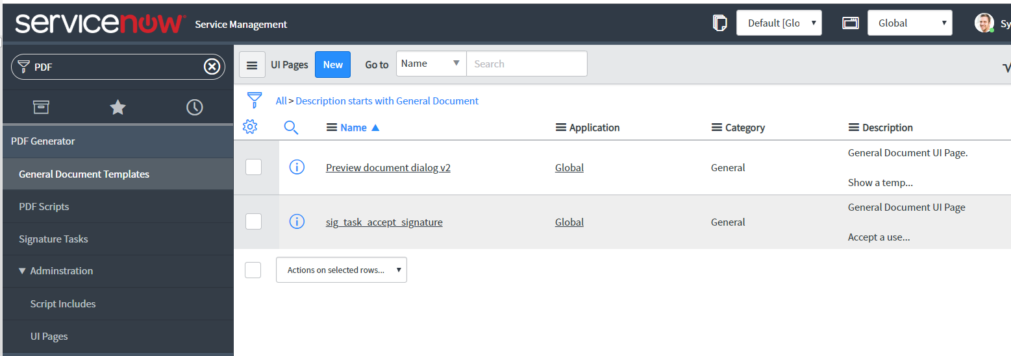

Slide 28
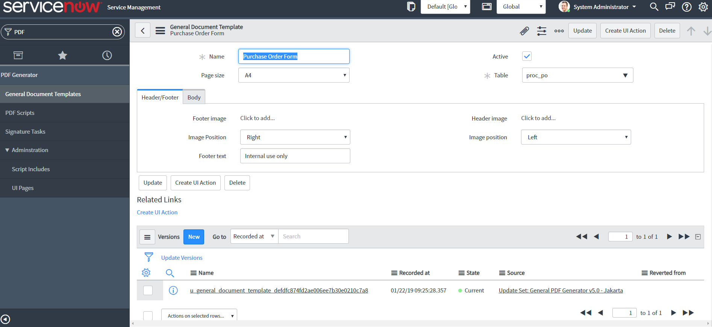

Slide 29
Interesting Code Snippets to keep in mind..
Pay Attention to Table Names …
(inserts / modifications were done via the Update Set we just ‘Commited’)

Slide 30
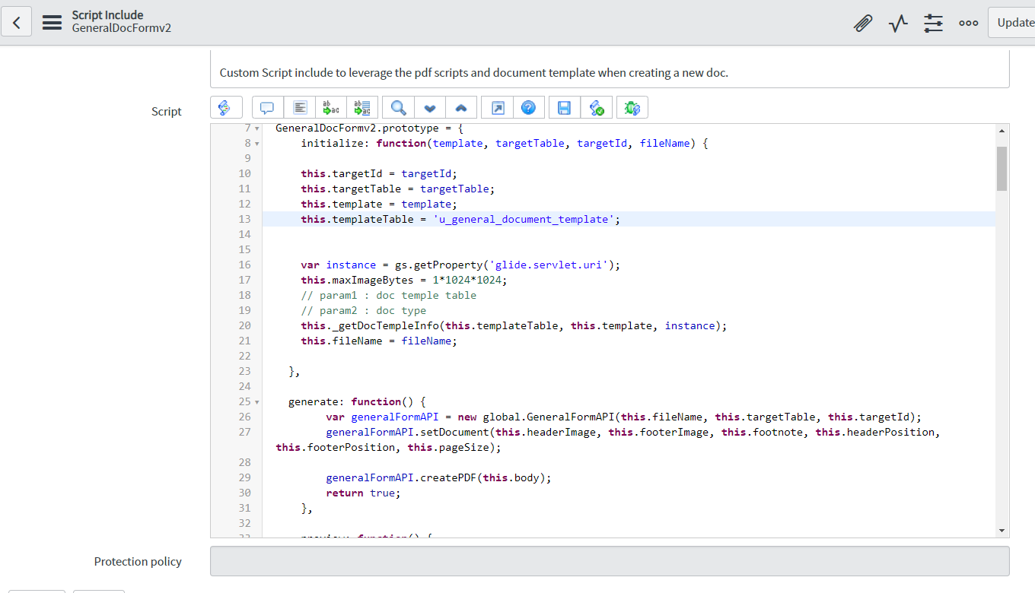
Huge difference in code between v1 and v2
Of the GeneralDocForm

Slide 31
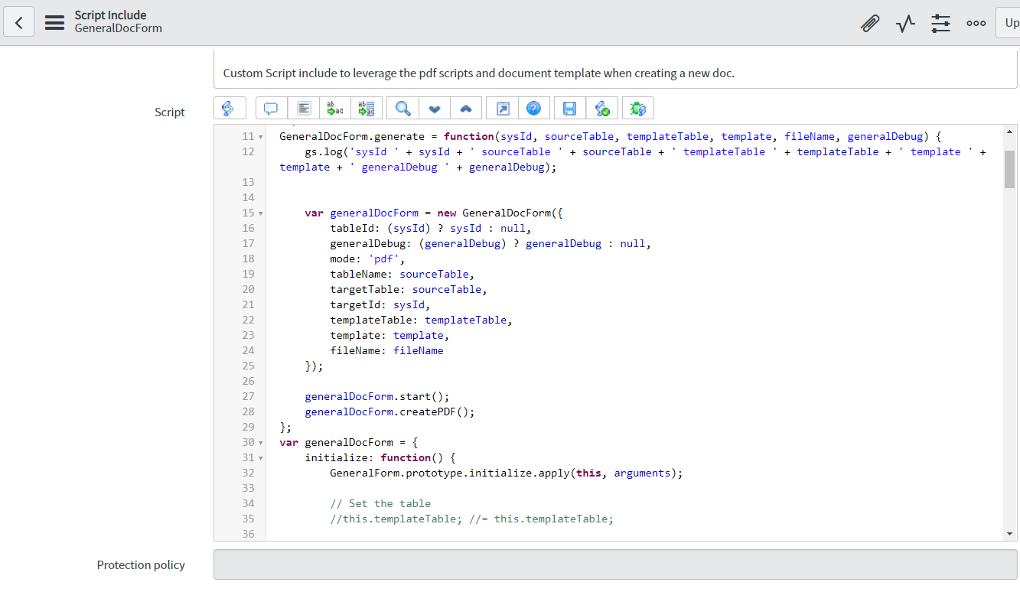
Huge difference in code between v1 and v2
Of the GeneralDocForm

Slide 32
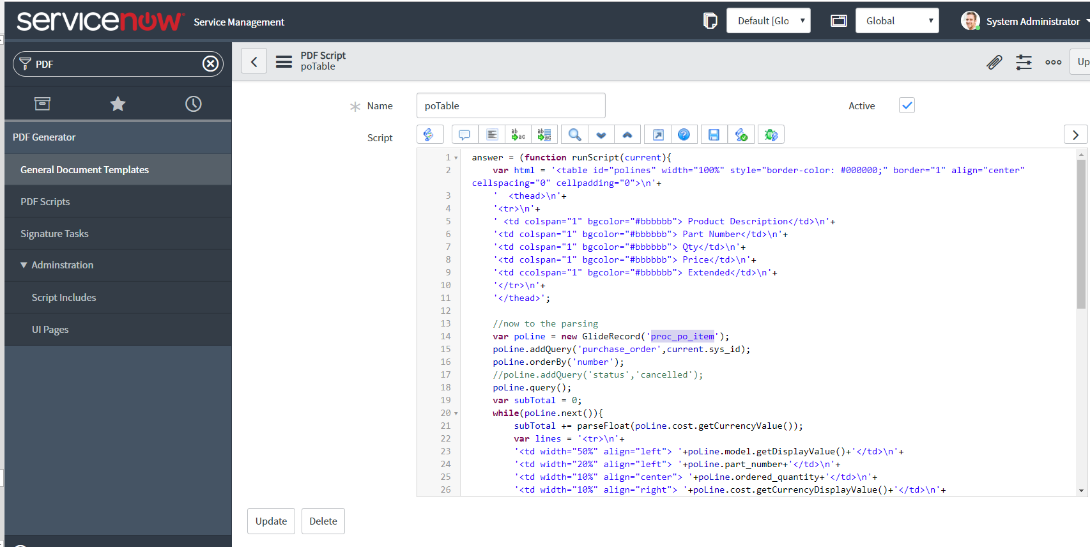

Slide 33


Slide 34
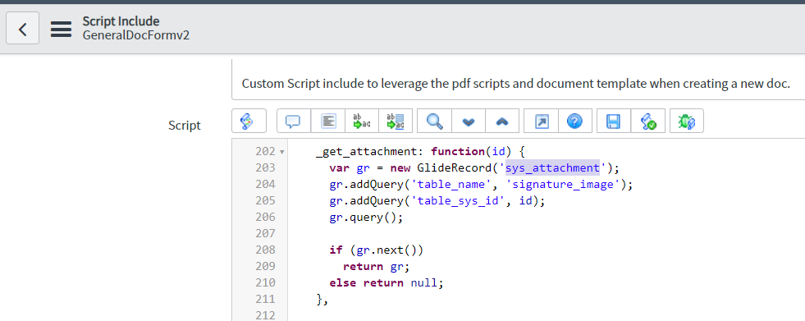

Slide 35
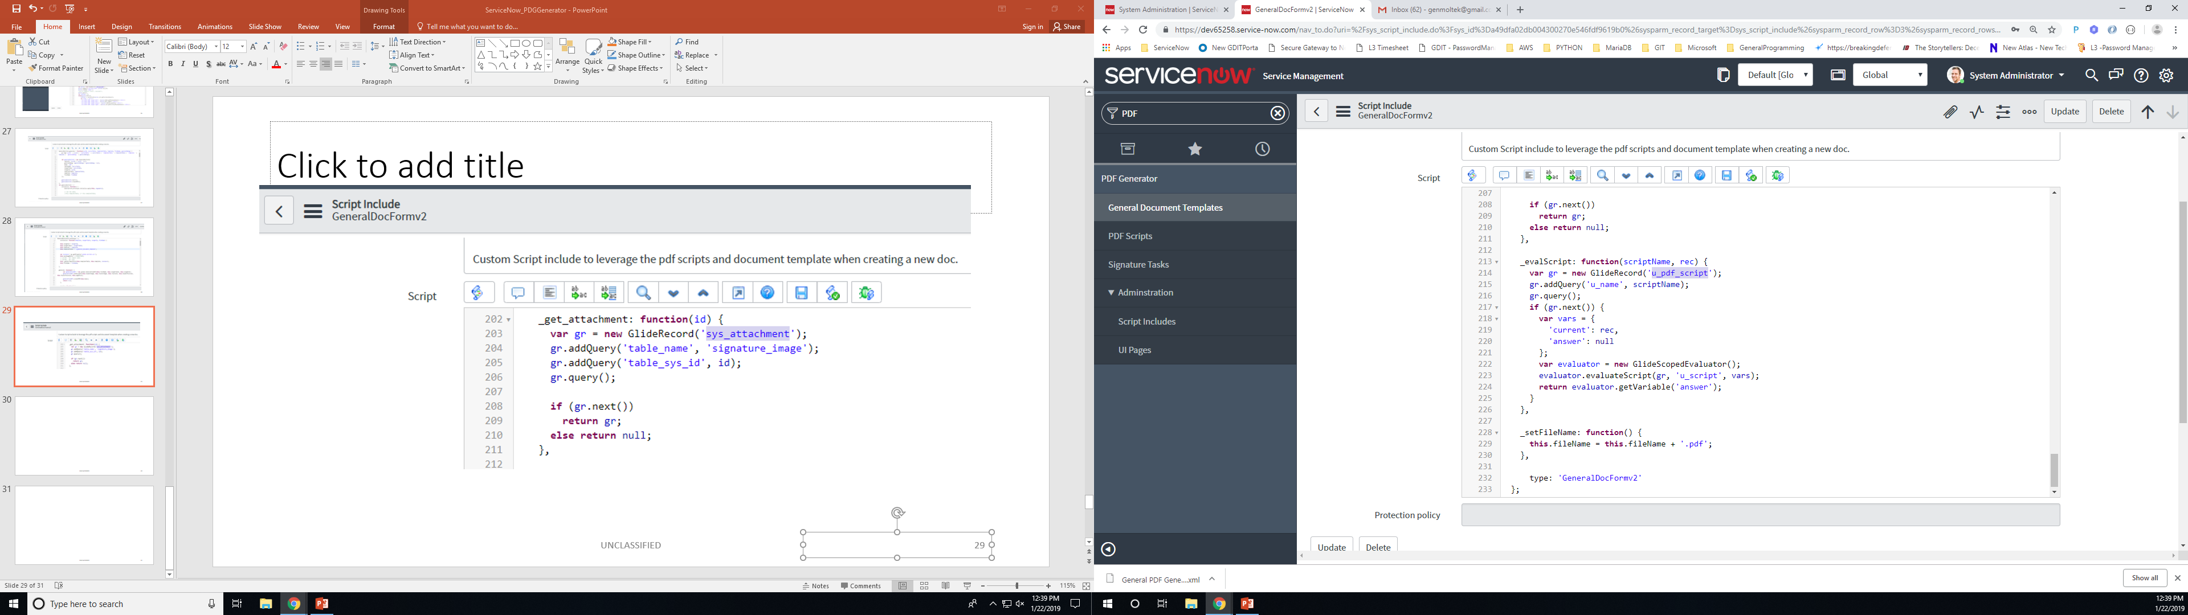

Slide 36
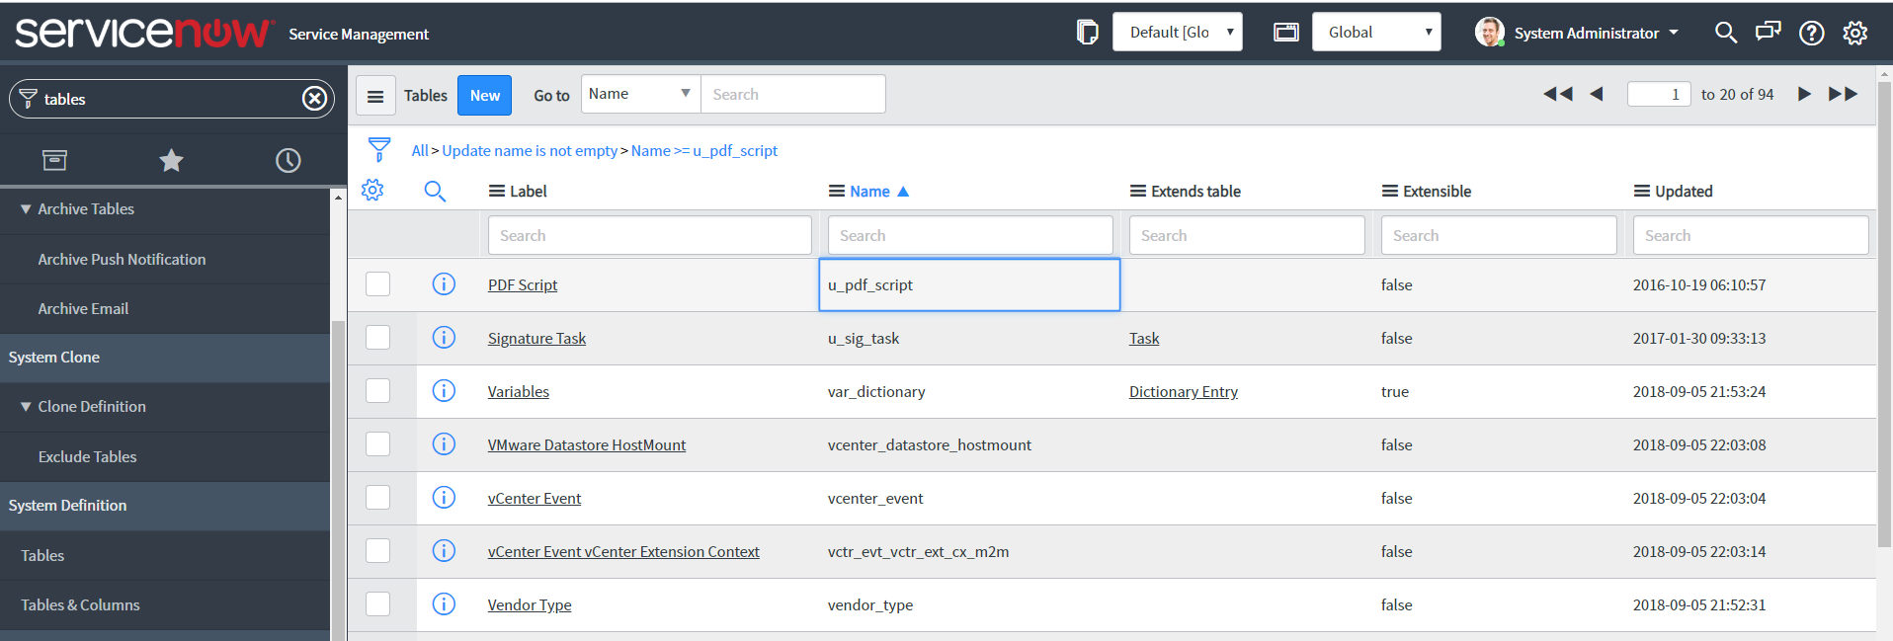
Verifying Tables and Code Match-Up
1
3
4
2

Slide 37

All Tables with “PDF” in their Label Label == Friendly Name

Slide 38
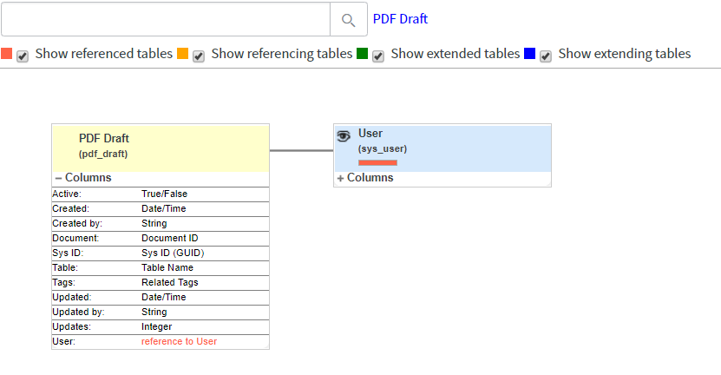
‘pdf_draft’ Info from the link: “Table Schema Map”

Slide 39
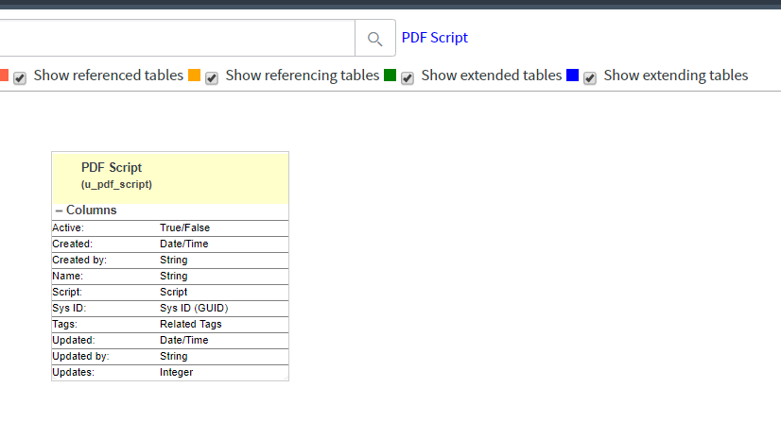
u_pdf_script Table Schema Map…

Slide 40
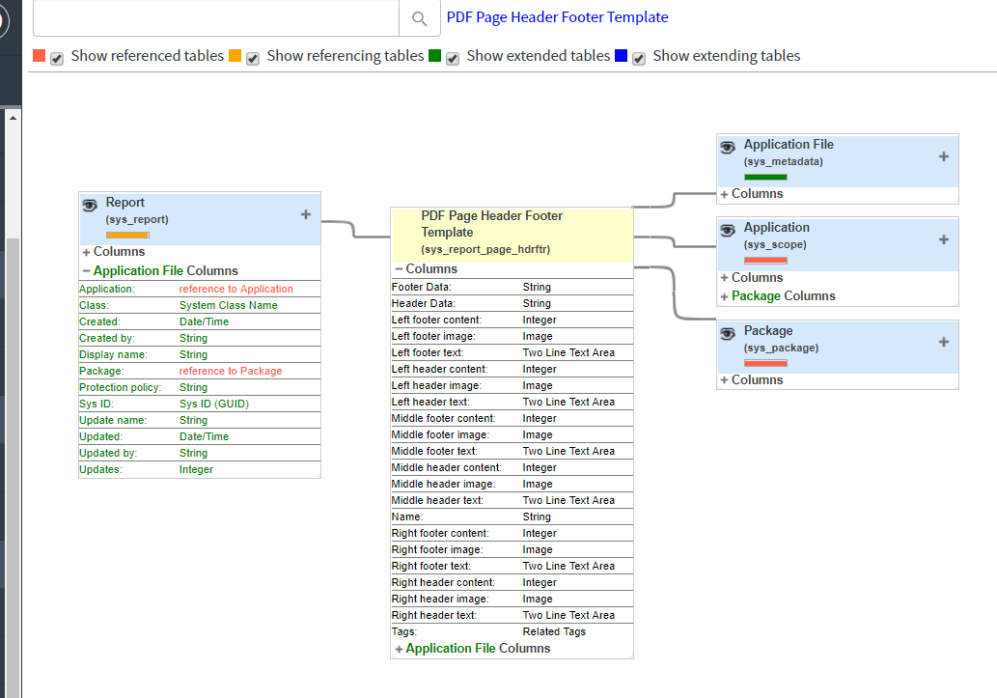
sys_report_page_hdrftr

Slide 41
Attaching the PDF from the Article
https://community.servicenow.com/community?id=community_blog&sys_id=4acc6265dbd0dbc01dcaf3231f961949
From the article “Filling PDF forms in ServiceNow”, the author “dylan,lindgren” provides a sample / fillable PDF file.
It seems that all PDF Documens for use with ServiceNow must be assigned to a Record in some Table in the Database.
In this example, the code is accessing a specific record in the incidents table. And retrieving the PDF to modify it.
So.. In our Developer Instance, we need to take the downloaded PDF copy and then attach it to a record.
Then, we can modify the sample code in the Article , to have the unique Incident Record ID that we know about.
To assign a PDF must open up the Incident Table.
For simplicity, sort the records by Most Recent Date, grab the 1st Record.
Mouse-Over the “I” (information) icon and a pop window displays with Metadata about the Record.
Holding down the SHIFT key allows focus to the pop up. There is a link near the top for “Managing Attachments”.
Clicking that link brings up another Dialog that can allow Uploading/Deleting of Attachments for this Record.

Slide 42
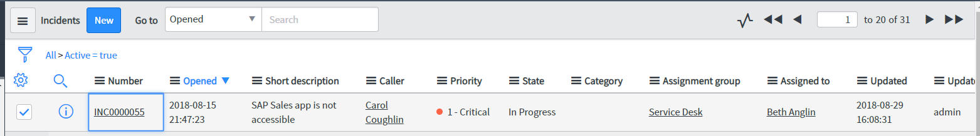
Sort Incidents Records by Date, pick 1st record (just arbitrary pick)
“INC0000055”

Slide 43
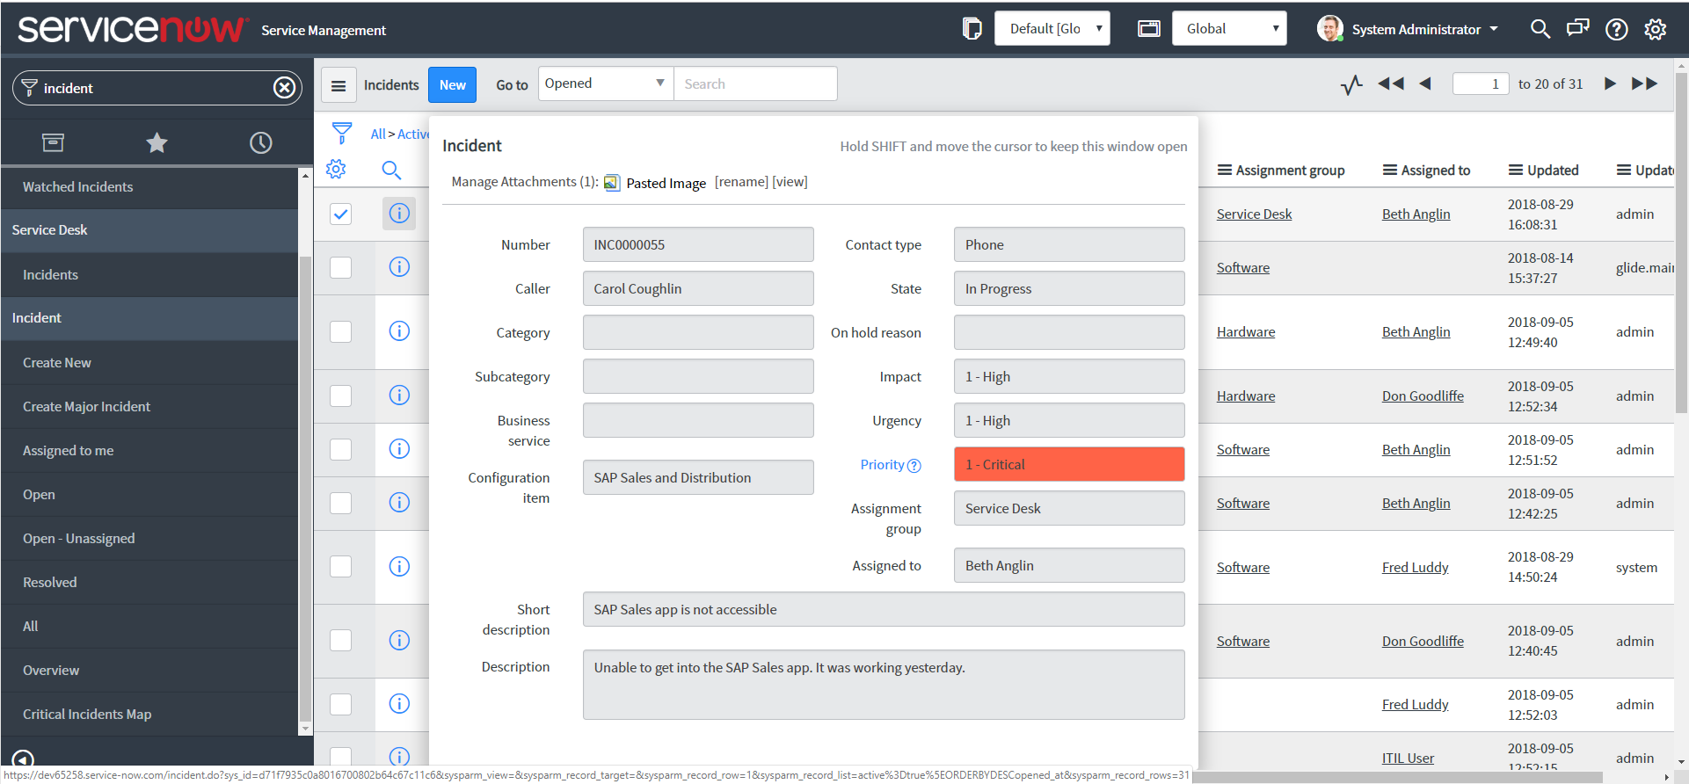
Viewing a Record in the Incident’s Table …
1
3
4
2

Slide 44
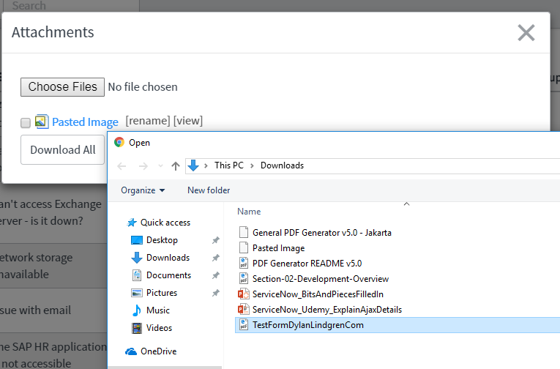
Select the sample PDF from the Article…

Slide 45
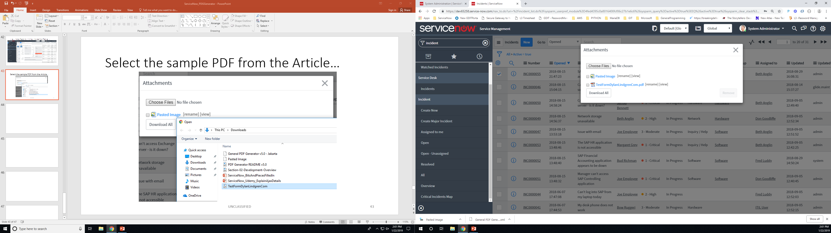
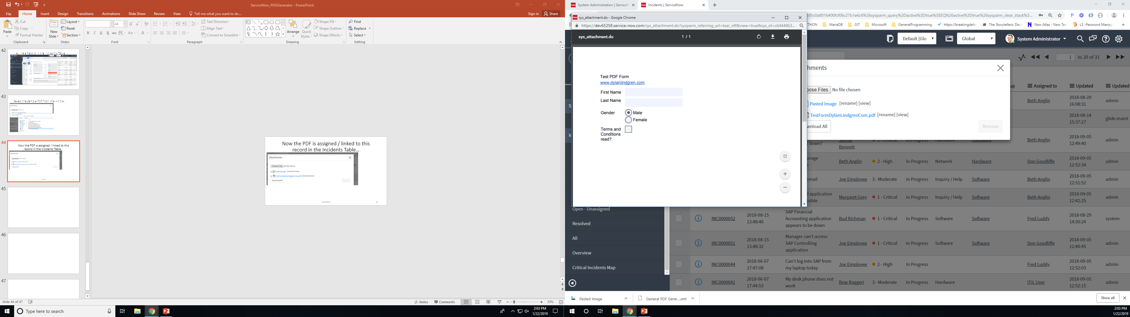
Now the PDF is assigned / linked to this record in the Incidents Table…

